Slide 1
Reviving Old Tech With The Pi Pico
By none other than the guy who lost his slides
“pffft, who needs backups, right?”

Slide 2
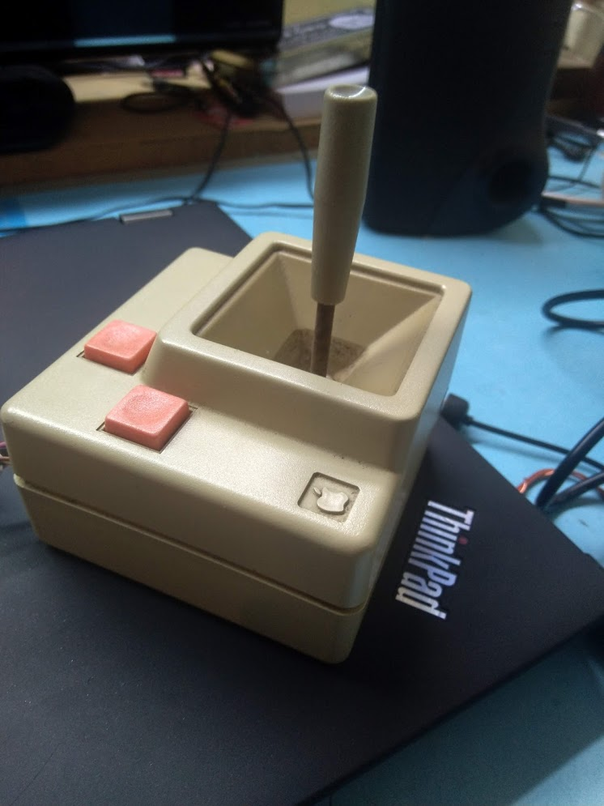
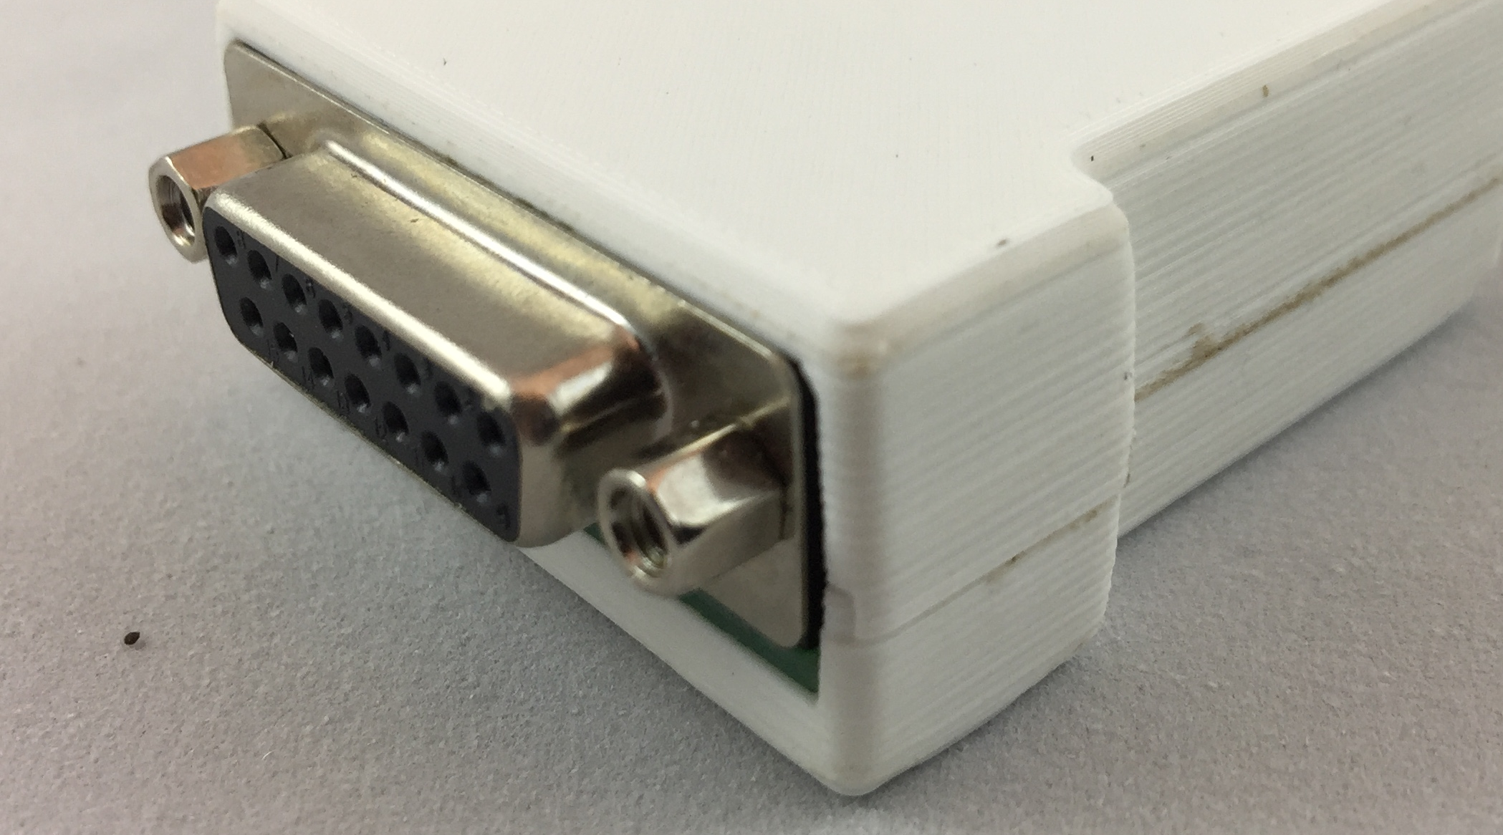
Retro Tech
Retro tech is cool.
Compatibility with retro tech isn’t.

Slide 3
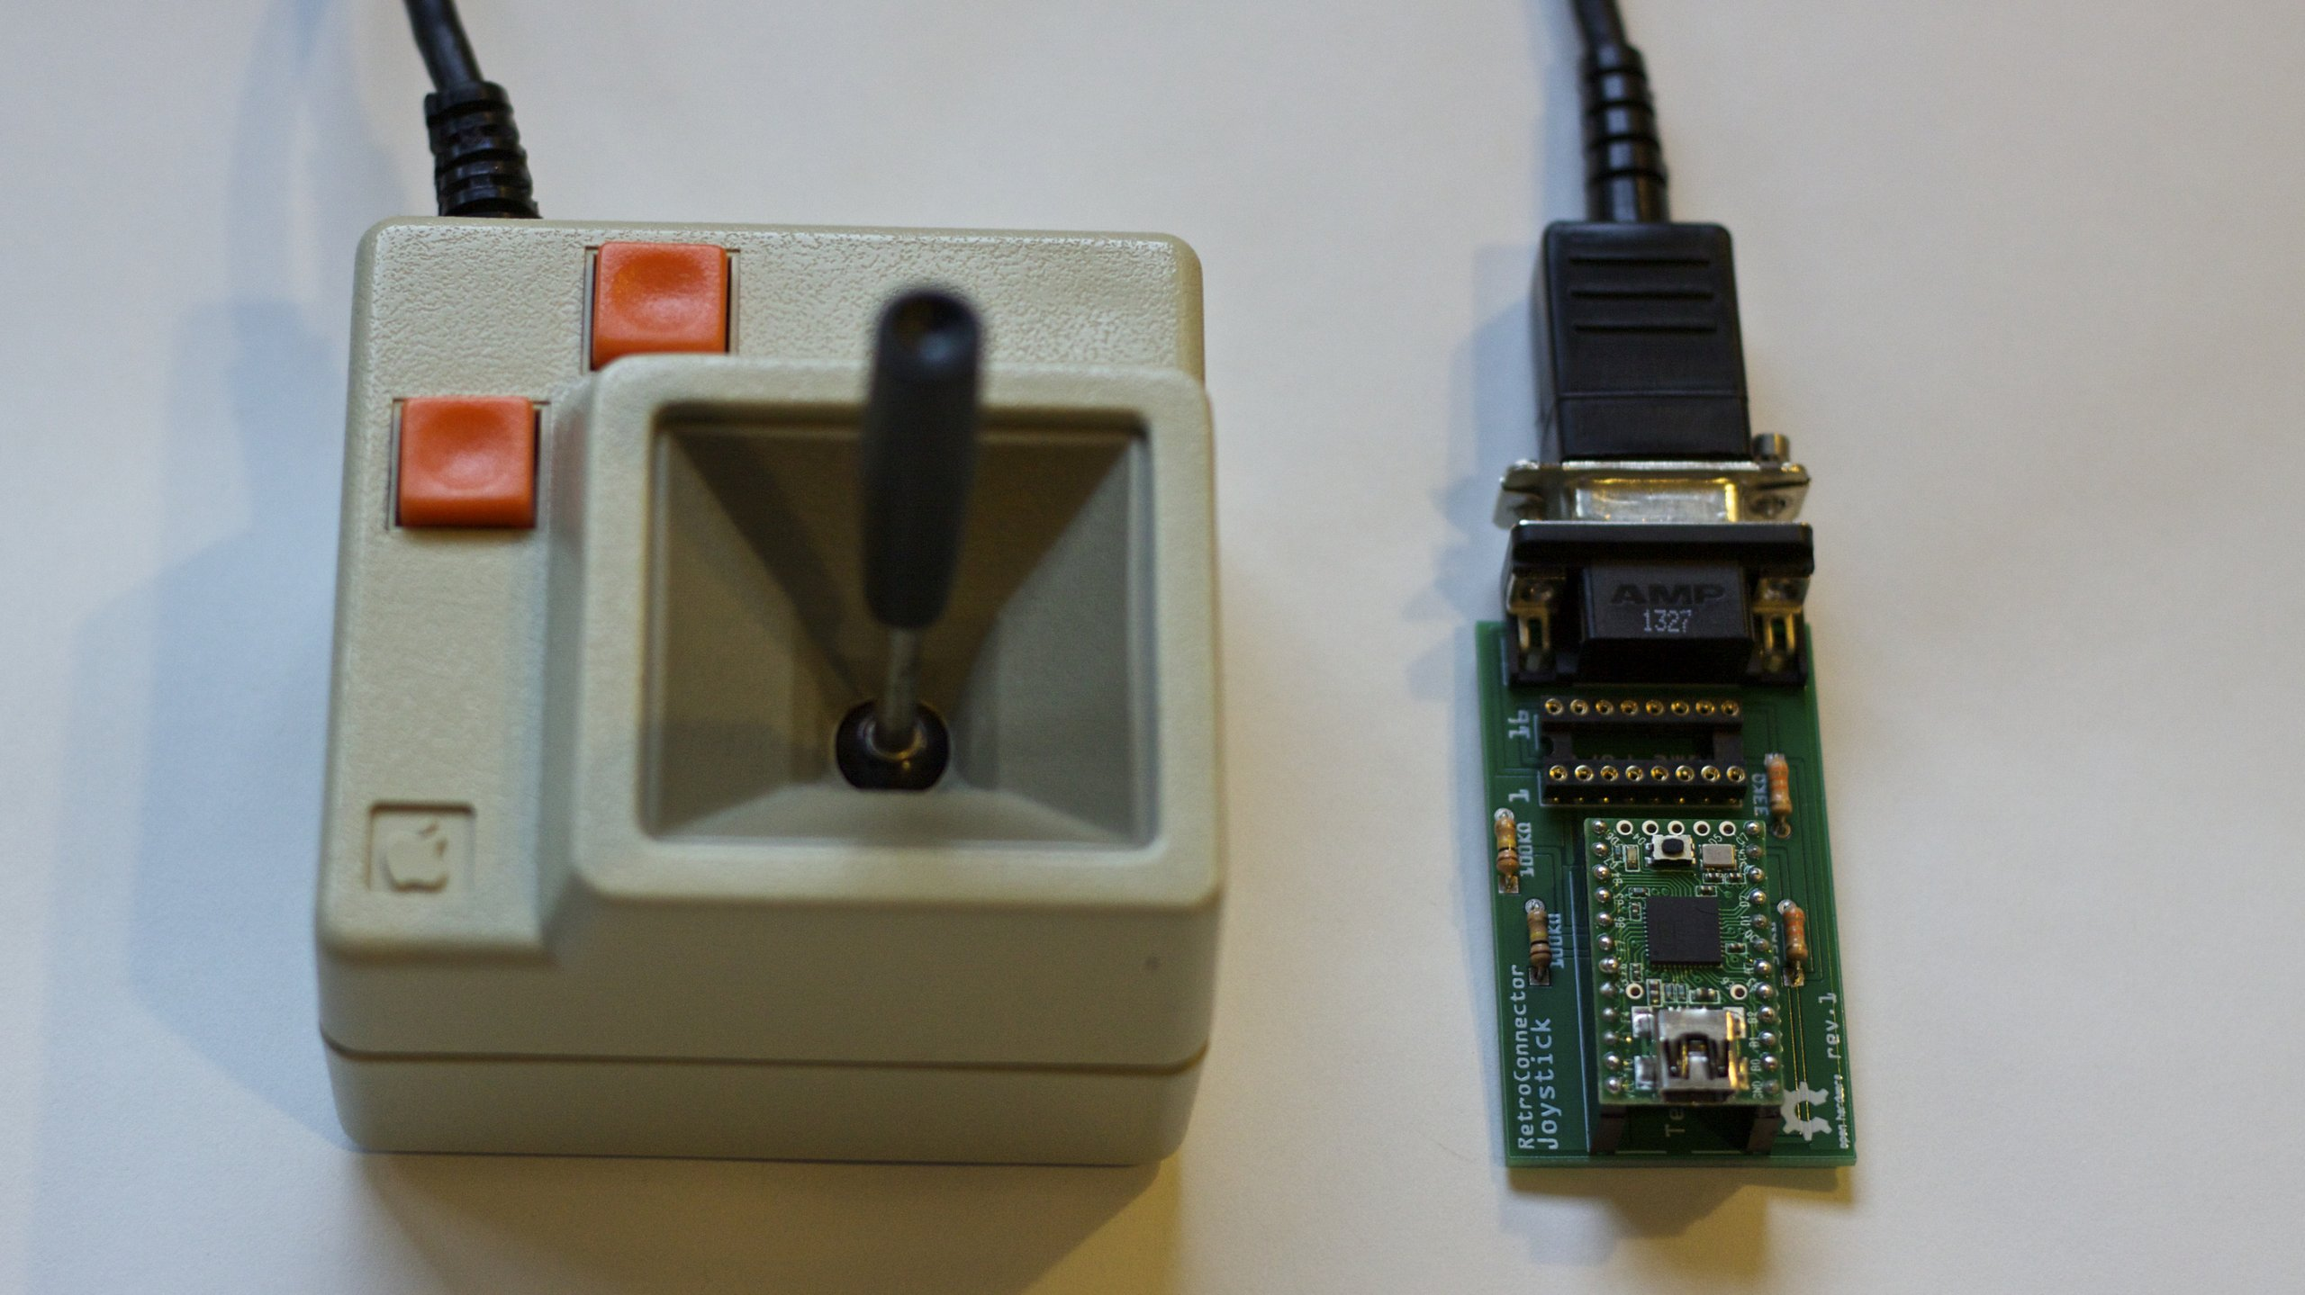
How It Used To Be Done
Custom PCB
ICs
Which are...
Expensive
Complex
Time Consuming

Slide 4
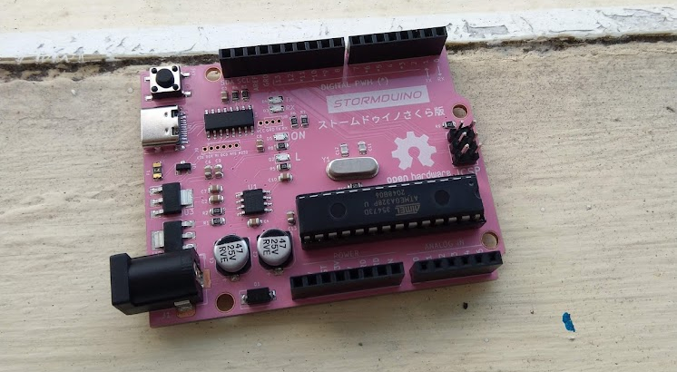
Introducing the Arduino
Cheap
Easy to use
Convenient to program

Slide 5
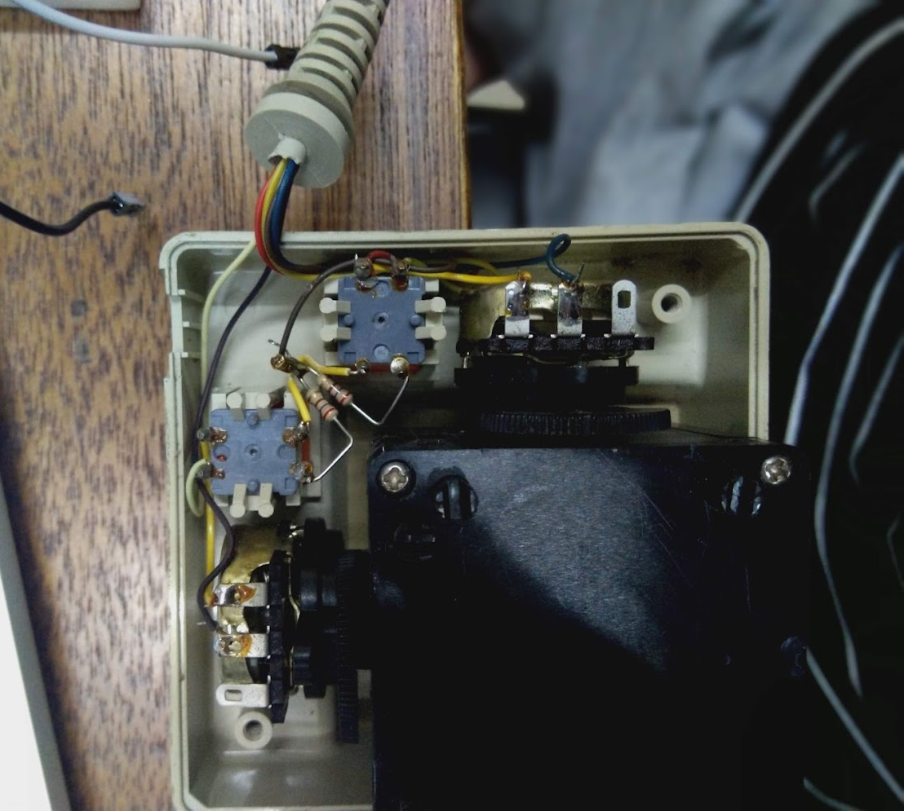
Cue Workshop Music
Nothing a screwdriver can’t fix break
Try to understand what the ancient hardware guys did
Fail

Slide 6
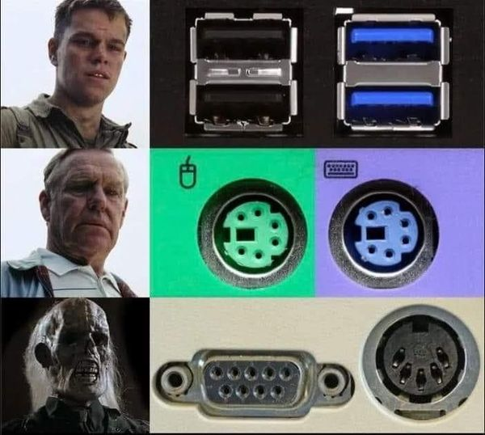
Am I Too Young?
Necromancy is illegal
I cannot just find someone to tell me how it works

Slide 7
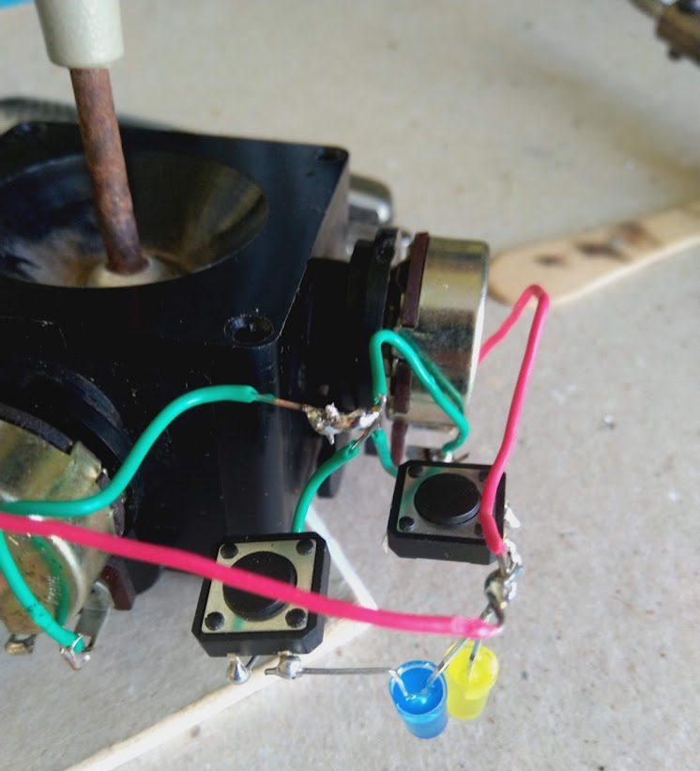

Solder like a Chimpanzee
Try not to inhale solder smoke :)

Slide 8
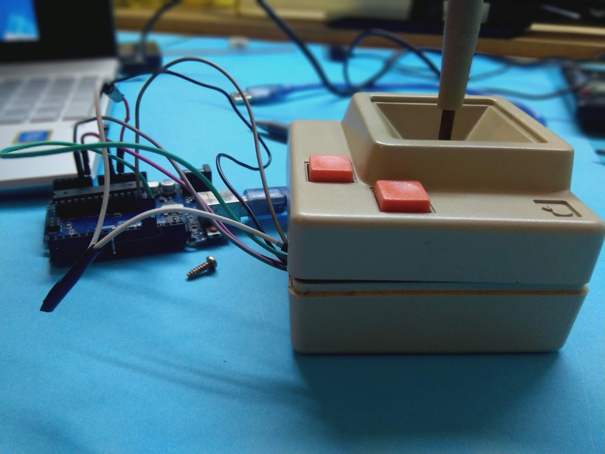
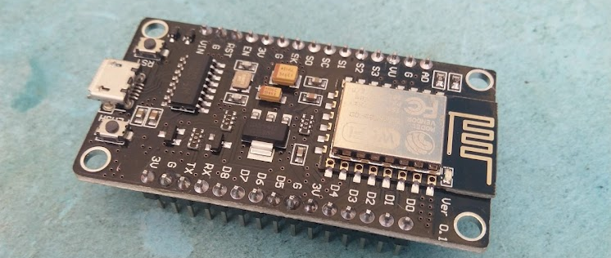
Learn to Comb Spaghetti
Connect the wires to the Arduino
Connect the Arduino to the PC

Slide 9
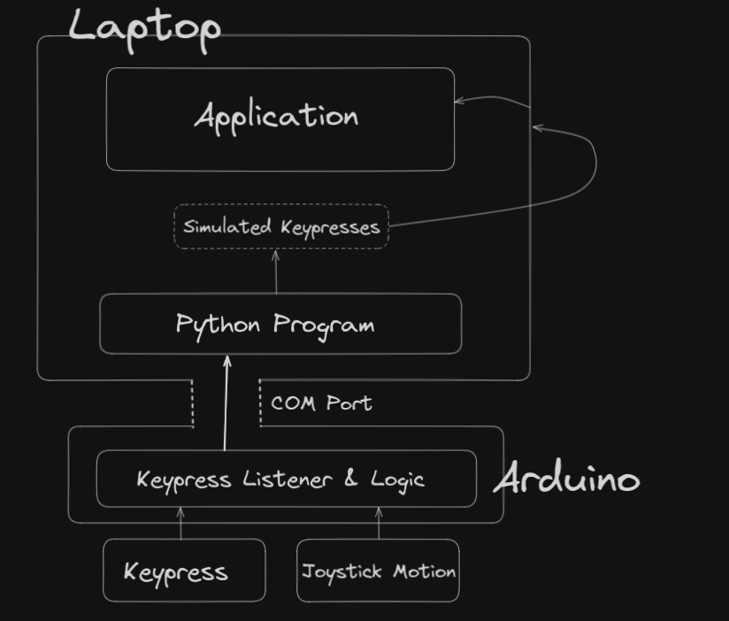

Slide 10
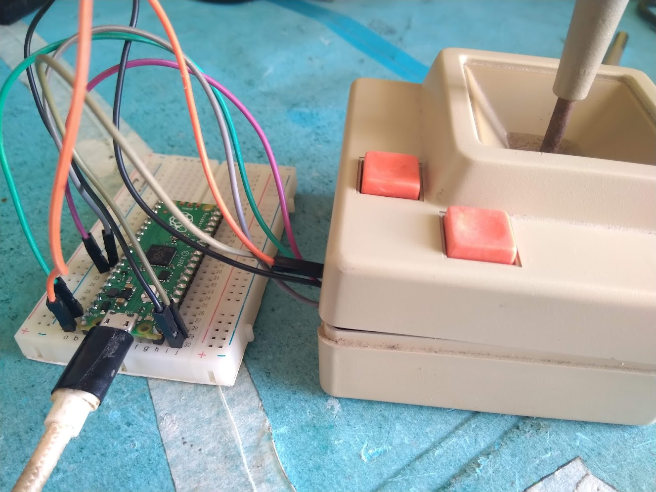
Introducing the Pico
$6
Python
Can emulate a keyboard

Slide 11
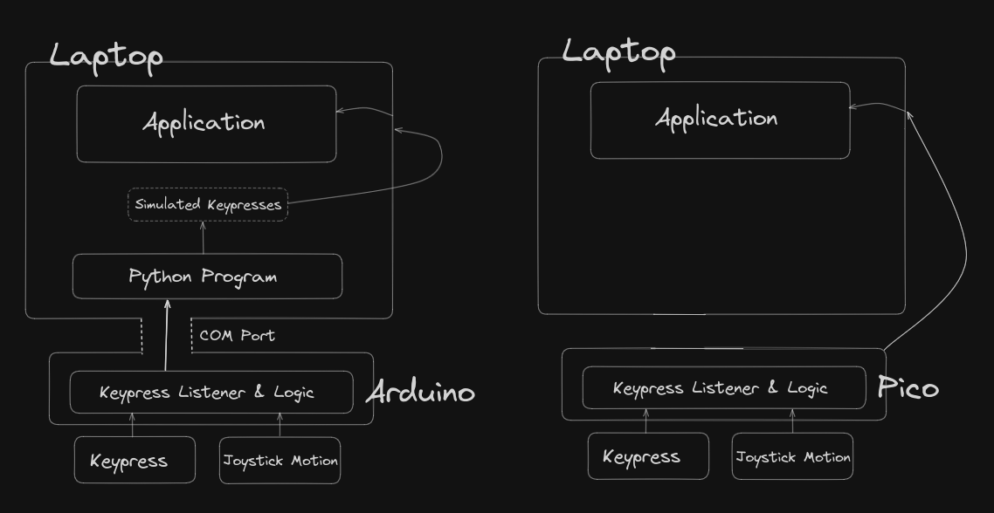
Cleaning Up My Mess

Slide 12
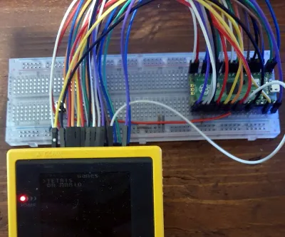
Power Anything with the Pico

Slide 13
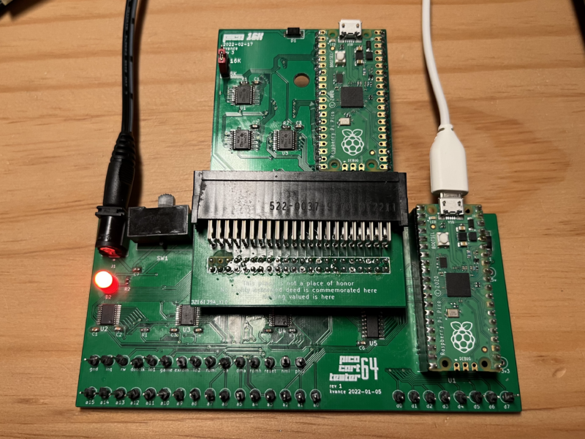
Power Anything with the Pico

Slide 14
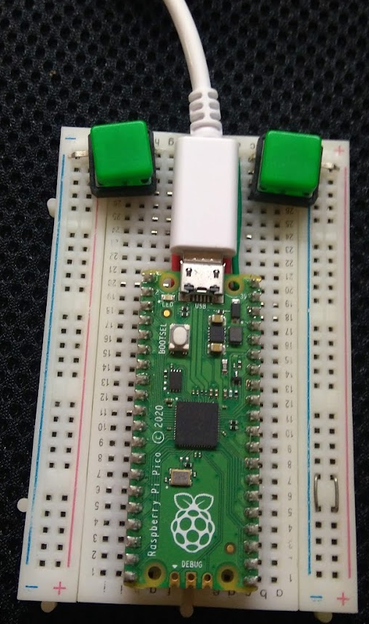
Power Anything with the Pico

